Slide 1


AUTONOMOUS PROJECT
UPM-SDPR
Faculty of Engineering
Institute of Advanced Technology
Universiti Putra Malaysia
43400 UPM Serdang, Selangor Darul Ehsan, Malaysia

Slide 2
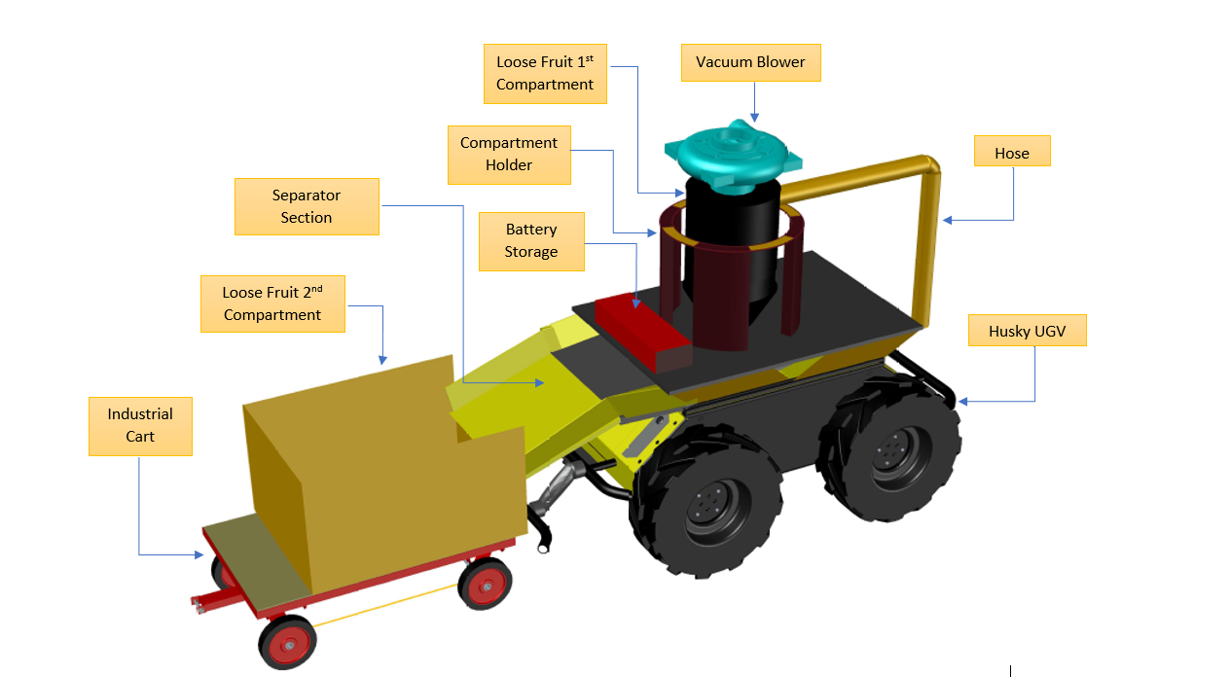
Project title: Autonomous Robot Loose Fruit Collector
(Model)

Slide 3
Project title: Autonomous Robot Loose Fruit Collector
Progress Plans
Stage 1/3: Autonomous Robot
Stage 2/3: Vacuum Custom Design
Stage 3/3: Loose Fruit Detection

Slide 4
Full Schedule : Status
Stage | Status |  |  | Target of Completion (2021)
 | Purchasing | Assemble and Design | Testing | View by SDPR
Design, Test and verify of Autonomous Robot for outdoor environment navigation | ✔ |  |  |  | March - May
Develop, test and verify of palm oil loose fruit detection | ✔ | ✔ |  |  | March - April
Design, test and verify of Vacuum System | ✔ |  |  |  | March - May
Integration of ARLFC |  |  |  | June - July
Field Testing |  |  |  | July - Sept
Modification/Verification |  |  |  | July - November
POC |  |  |  | November
Completion of ARLFC (deployed and delivered) |  |  |  | December

Slide 5
In Parallel Project!
Project title: Automatic Tractor Grabber for Palm oil Plantation
WORKING CONCEPT/PRINCIPLE
Modify the existing tractor grabber (cost)
Apply proportional controller system to existing manual grabber without modifying existing system(Estimate hybrid mechanization system)
Assemble and install outdoor camera system for applying bunches image detection method
Type of Product – POC, Period – 6-12 months and Estimation Cost - RM100k – RM150k

Slide 6
In Parallel Project!
Project title: Autonomous Fertilizer ATV
Status: Collecting Data
WORKING CONCEPT/PRINCIPLE
Modify the existing ATV
Apply autonomous system (outdoor navigation)
Apply detection system (outdoor detection)
Assemble autonomous fertilizer arm system
Type of Product – POC, Period – 6-12 months and Estimation Cost – RM400k – RM500k

Slide 7
Future Project:
Project title: Autonomous Harvester UGV
WORKING CONCEPT/PRINCIPLE
MAJOR MODIFICATION of existing UGV
Apply autonomous system (outdoor navigation)
Apply detection system (outdoor detection)
Assemble autonomous cutter and collector system (CUSTOM DESIGNS)
(SHORT TERM) type of Product – POC, Period – 6-12 months and Estimation Cost – RM400k – RM500k
(LONG TERM) type of Product – POC, Period – 30-36 months and Estimation Cost – RM1.5M – RM2M
RnD GRANT
MORE EXPERTS MEMBER (MECHANIZATION)
NEW DESIGN OF UGV

Slide 8
Team Leader SDPR
Dr Harikrishna Kulaveerasingam
Hj. Ahmad Zamri Md Yusof
Dr. Mohd Zulfahmi Mohd Yusoff
Team Member
Team Leader UPM
Assoc. Prof. Ts. Dr. Wan Zuha Wan Hasan
(RISE MOSTI PROGRAM UPM-SDPR)
Advisor
Prof. Ir. Dr Mohd Zainal Abidin Abd Kadir
Prof Madya Dr Norhafiz Azis
Prof Madya Dr Suhaidi Shafie

Slide 9
Team Autonomous
Researcher | Position | Research Area
Dr Hafiz Rashidi@Harun | lecturer | Robotic/Image Processing
Dr Luthffi Idzhar Ismail | Lecturer | Robotic/ROS System/Navigation
Khairul Izwan Kamsani | Postgraduate | Robotic/AI
Alireza Ahmadi | Postgraduate | Robotic/Object Detection
Ahmed Fareed Japar | Postgraduate | Robotic/ROS System/Navigation
Muhammad Nasih Ulwan Abd Wahab | Undergraduate | Mobile Robot
Ahmad Afiq Mustaqim Mohd Radzi | Undergraduate | Mobile Robot
Muhammad Syahir Bin Zamasry | Undergraduate | Mobile Robot
Team Member

Slide 10
Team Mechanization
Researcher | Position | Research Area
Dr. Muhamad Saufi Mohd Kassim | lecturer | Mechanization
Dr. Hazreen Haizi Harith | Lecturer | Mechanization
Prof. Madya Dr. Nazmi Mat Nawi | Lecturer | Mechanization
Muhammad Farhan Mustafa | Postgraduate | Vacuum System
Mohd Ruzaimi Mohd Ariffin | Postgraduate | Tractor (Grabber)
Hassan Qassim | Postgraduate | Tractor (Grabber)
Team Member

Slide 11

Terima Kasih | Thank You

